Slide 1
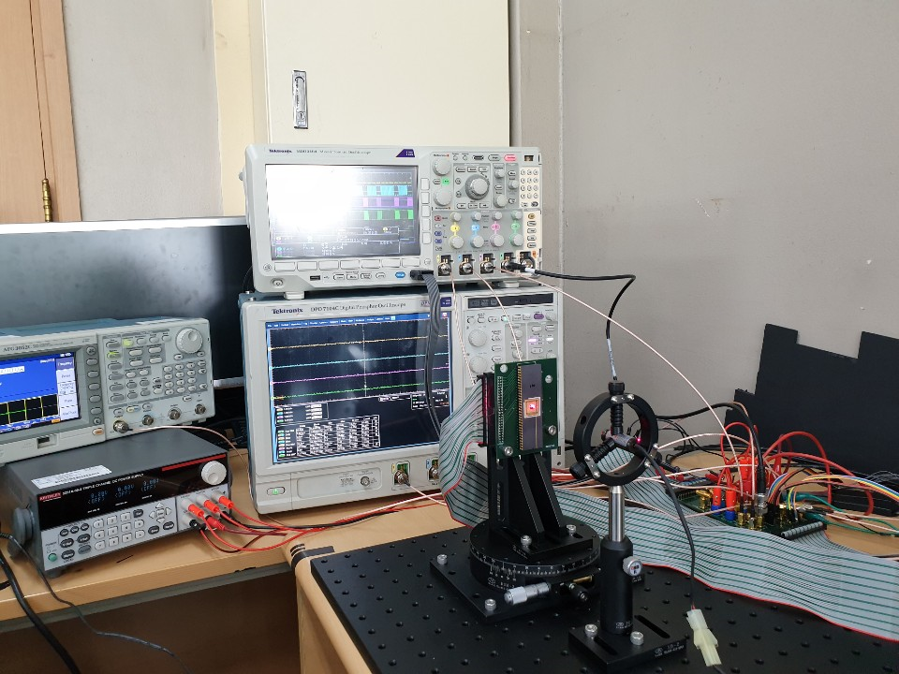
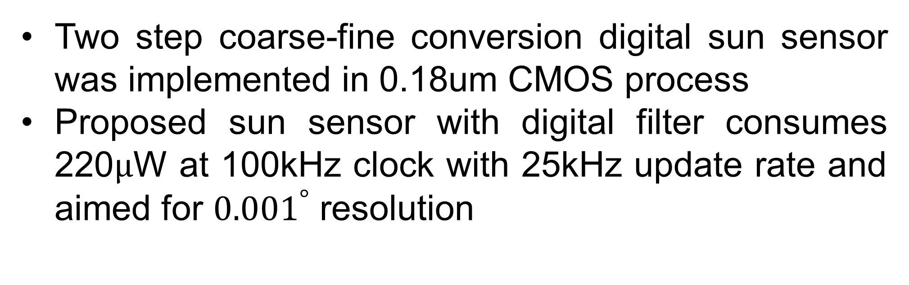



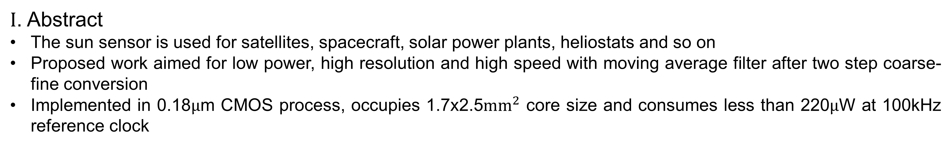


A Low-Power CMOS Monolithic Sun Sensor with Integrated Window Layer and Light-to-Digital Convertor
In-Ho Song Dong-Woo Jee
Department of Electronic Engineering,
Ajou University, Suwon, Korea
dwjee@ajou.ac.kr
$Ι$. Abstract
The sun sensor is used for satellites, spacecraft, solar power plants, heliostats and so on
Proposed work aimed for low power, high resolution and high speed with moving average filter after two step coarse-fine conversion
Implemented in 0.18$μ$m CMOS process, occupies 1.7x2.5${mm}^{2}$ core size and consumes less than 220$μ$W at 100kHz reference clock
$II$. Proposed Work
Conventional work
Proposed Concept
Proposed two step coarse-fine conversion could reduce power consumption
Moving average filter after fine conversion in this work, aimed for high resolution with adjusting sampling clock speed
Rate between digital filter outputs could get better accuracy and robust to other distractors
Window layer
Proposed circuit diagram
$III$. Simulation
$V$. Conclusion
${52}^{°}$ LDC measurement
Two step coarse-fine conversion digital sun sensor was implemented in 0.18um CMOS process
Proposed sun sensor with digital filter consumes 220$μ$W at 100kHz clock with 25kHz update rate and aimed for ${0.001}^{°}$ resolution
${60}^{°}$ LDC measurement
Chip Photomicrograph
Test setup

